Slide 1
Animals Unit Activity 2.4: Questions about Animals
Carbon: Transformations in Matter and Energy
Environmental Literacy Project Michigan State University
Notes:
Image Credit: Craig Douglas, Michigan State University

Slide 2
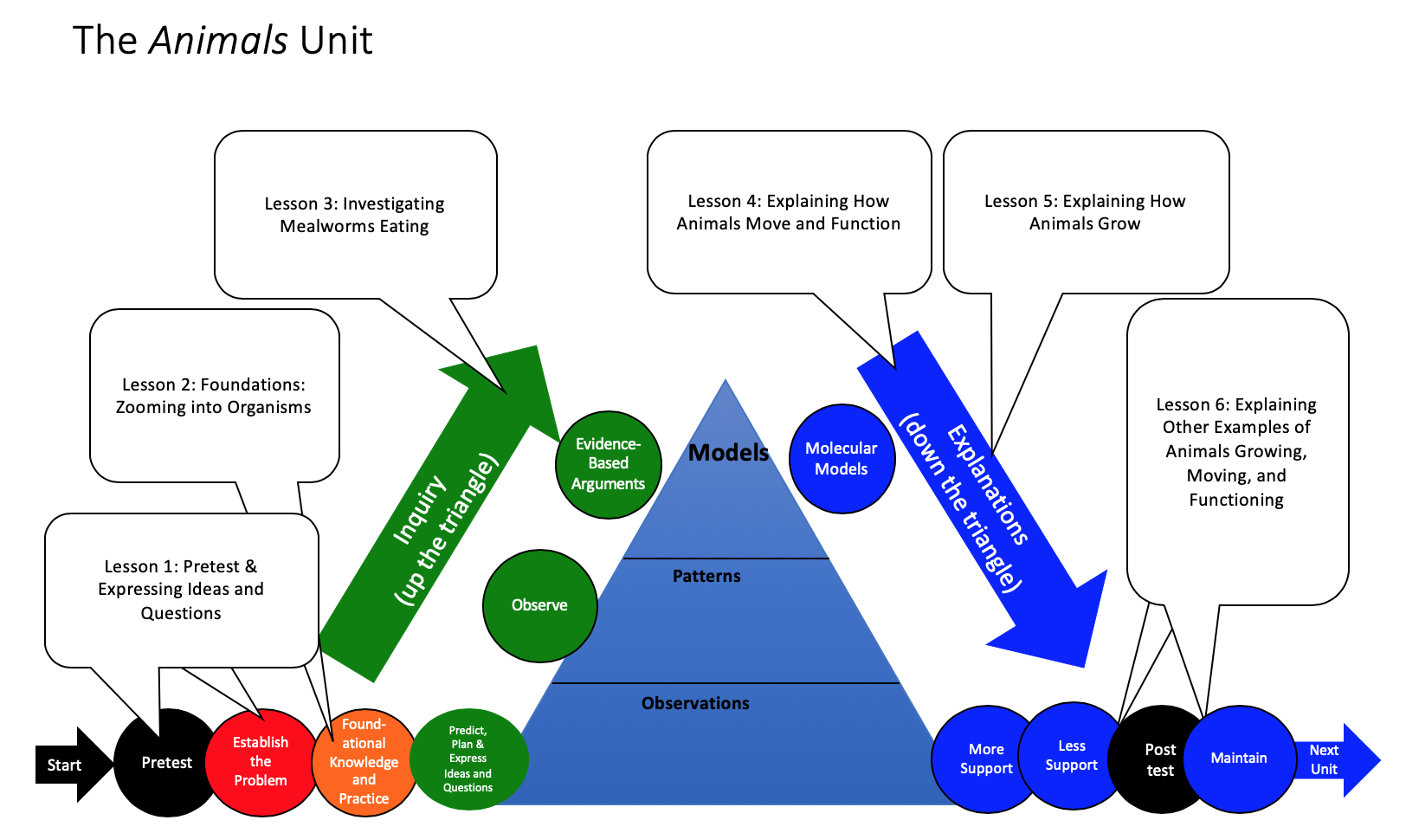
Unit Map
You are here
Notes:
Use the instructional model to show students where they are in the course of the unit.
Show slide 2 of the 2.4 Questions About Animals PPT.

Slide 3
Mealworms
Notes:
Introduce mealworms.
Tell students that they will be investigating mealworms in the next lesson to try to answer their questions.
Show slide 3 and the video of mealworms eating a carrot (http://www.youtube.com/watch?v=xRYE0JjHYoQ ). Have students share their observations and discuss how mealworms are similar and different from a child or other animals.
If you already have mealworms for the investigation, you can have students observe actual mealworms instead of watching the video.

Slide 4
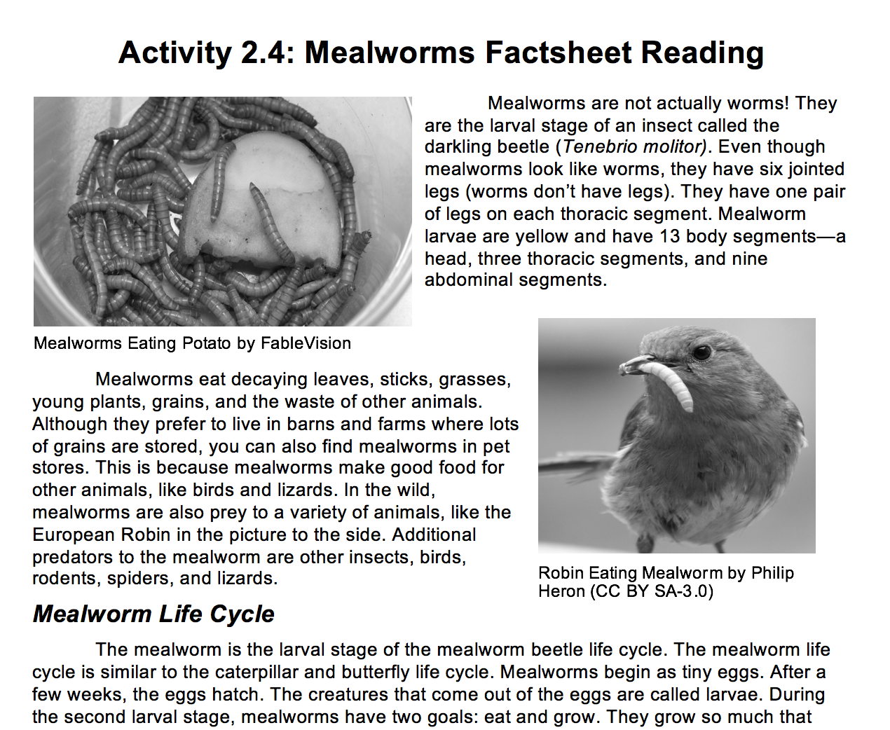
Reading
Read the “Mealworms Factsheet Reading” using the Questions, Connections, Questions Reading Strategy.
Notes:
Have students read about mealworms.
Show slide 4 of the PPT. Pass out a 2.4 Mealworms Factsheet Reading to each student or pair of students. Read together as a class or have students read in pairs.
Have students pause and discuss the italicized questions.
After reading, allow students to share what they found interesting about mealworms, including the differences in what molecules make up mealworms compared to the molecules in their food. Student should notice that mealworms eat food composed mainly of carbohydrates, but mealworms are not. The reason for this is an unanswered question that students will consider in later lessons.
Show slide 5 of the PPT. Have students share their ideas about how mealworms are like other animals, including a child. students will consider in later lessons.

Slide 5
How are mealworms like other animals? How are they like a child?
Notes:
Show slide 5 of the PPT. Have students share their ideas about how mealworms are like other animals, including a child. .

Slide 6
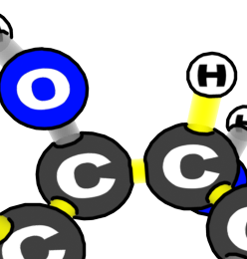
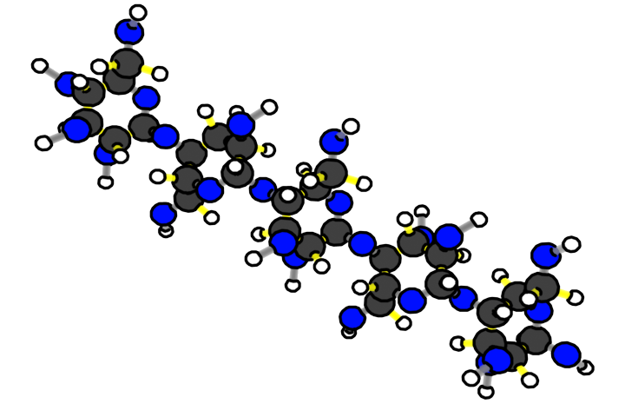
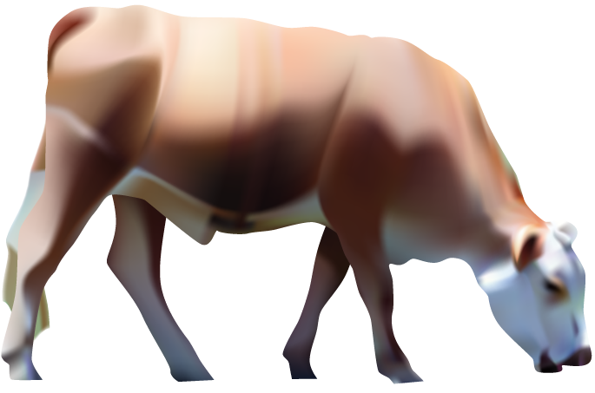
Animals are made of cells
Animal molecules are made of atoms
Animal cells are made of molecules
Benchmark Scale | Power of Ten | Decimal Style
Large scale | Larger 10⁵ 10⁴ 10³ | Larger 100,000 10,000 1,000
Macroscopic | 10² 10¹ 10⁰ 10⁻¹ 10⁻² 10⁻³ | 100 10 1 meter 0.1 0.01 0.001
Microscopic | 10⁻⁴ 10⁻⁵ 10⁻⁶ 10⁻⁷ | 0.0 001 0.00 001 0.000 001 0.0 000 001
Atomic-molecular | 10⁻⁸ 10⁻⁹ Smaller | 0.00 000 001 0.000 000 001 Smaller
Scale: 10⁻⁸ meters = 0.00 000 001 meters
Scale: 10⁻⁹ meters = 0.000 000 001 meters
Scale: 10⁻⁶ meters = 0.000 001 meters
Scale: 10⁻⁷ meters = 0.0 000 001 meters
Scale: 10⁻⁵ meters = 0.00 001 meters
Scale: 10⁻⁴ meters = 0.0 001 meters
Scale: 10⁻³ meters = 0.001 meters
Scale: 10⁻² meters = 0.01 meters
Scale: 10⁰ meters = 1 meters
Scale: 10⁻¹ meters = 0.1 meters
Notes:
Image Credit: Craig Douglas, Michigan State University
Show slides to zoom in to animals.
Show students slides 6-9 of 2.4 Questions about Animals PPT
Slide 6 animates zooming in to an animal.
Slide 7 shows the diversity of shapes and sizes of animals
Slide 8 shows that despite the diversity in slide 7 that all animals are made of different types of cells.
Slide 9 shows that all animal cells are made up of the same types of large organic molecules.
Have students discuss the scales at which all animals are more alike than different (the cellular and atomic-molecular scale). scale).

Slide 7
Animals come in all shapes and sizes
Notes:
Image Credit: Craig Douglas, Michigan State University
Show slides to zoom in to animals.
Show students slides 6-9 of 2.4 Questions about Animals PPT
Slide 6 animates zooming in to an animal.
Slide 7 shows the diversity of shapes and sizes of animals
Slide 8 shows that despite the diversity in slide 7 that all animals are made of different types of cells.
Slide 9 shows that all animal cells are made up of the same types of large organic molecules.
Have students discuss the scales at which all animals are more alike than different (the cellular and atomic-molecular scale).

Slide 8
Animals have many different kinds of cells
Inside intestine
Blood
Skin cells
Digestive system cells
Muscle cells
Nerve cells
Notes:
Image Credit: Craig Douglas, Michigan State University
Show slides to zoom in to animals.
Show students slides 6-9 of 2.4 Questions about Animals PPT
Slide 6 animates zooming in to an animal.
Slide 7 shows the diversity of shapes and sizes of animals
Slide 8 shows that despite the diversity in slide 7 that all animals are made of different types of cells.
Slide 9 shows that all animal cells are made up of the same types of large organic molecules.
Have students discuss the scales at which all animals are more alike than different (the cellular and atomic-molecular scale).

Slide 9
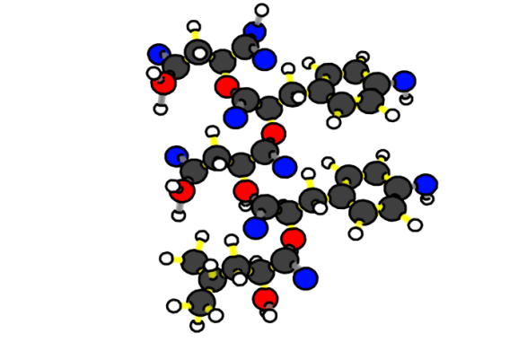
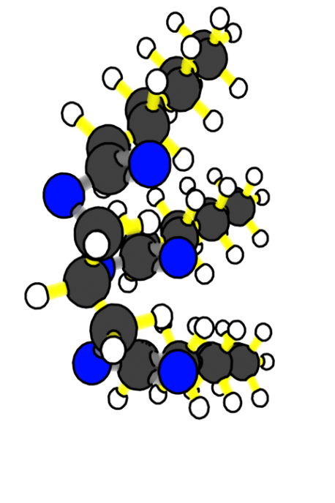
Cells are made of large organic molecules
Muscle cells
Proteins
Fats
Notes:
Image Credit: Craig Douglas, Michigan State University
Show slides to zoom in to animals.
Show students slides 6-9 of 2.4 Questions about Animals PPT
Slide 6 animates zooming in to an animal.
Slide 7 shows the diversity of shapes and sizes of animals
Slide 8 shows that despite the diversity in slide 7 that all animals are made of different types of cells.
Slide 9 shows that all animal cells are made up of the same types of large organic molecules.
Have students discuss the scales at which all animals are more alike than different (the cellular and atomic-molecular scale). scale).

Slide 10
What else do we know about matter and energy in animals?
What are rules about matter should we follow when investigating and explaining how animals grow, move, and function?
What are rules about energy should we follow when investigation how animals grow, move, and function?
Notes:
Review the Three Questions and Rules to Follow.
Show slide 10 of the PPT. Discuss with students how the rules about matter and energy also apply to mealworms.
Show slide 11 with the Three Questions. Remind students that when explaining animals, they will be answering the Three Questions which describe movements and changes in matter and energy
Review the rules to follow with students. Have students discuss how the rules to follow can apply to animals. .

Slide 11
Good answers to questions about animal cells
Answer each of the questions (numbered 1-4) below to explain how matter and energy move and change in a system. Note that matter movement is addressed at both the beginning (1) and end (4) of your explanation.
Question
Where are molecules moving?
How do molecules move to the location of the chemical change?
How do molecules move away from the location of the chemical change?
Evidence We Can Observe
Moving solids, liquids, and gases are made of moving molecules.
A change in mass shows that molecules are moving.
Rules to Follow
All materials (solids, liquids, and gases) are made of atoms that are bonded together in molecules.
Scale: The matter movement question can be answered at the atomic-molecular, cellular, or macroscopic scale.
Question
How are atoms in molecules being rearranged into different molecules?
What molecules are carbon atoms in before and after the chemical change?
What other molecules are involved?
Evidence We Can Observe
BTB can indicate CO₂ in the air.
Organic materials are made up of molecules containing carbon atoms:
• fuels • foods
• living and dead plants and animals
decomposers
Rules to Follow
Atoms last forever in combustion and living systems.
Atoms can be rearranged to make new molecules, but not created or destroyed.
Carbon atoms are bound to other atoms in molecules.
Scale: The matter change question is always answered at the atomic-molecular scale.
Question
What is happening to energy?
What forms of energy are involved?
What energy transformations take place during the chemical change?
Evidence We Can Observe
We can observe indicators of different forms of energy before and after chemical changes:
• light energy • heat energy
• chemical energy stored in organic materials
• motion energy
Rules to Follow
Energy lasts forever in combustion and living systems.
Energy can be transformed, but not created or destroyed.
C-C and C-H bonds have more stored chemical energy than C-O and H-O bonds.
Scale: The energy change question can be answered at the atomic-molecular, cellular, or macroscopic scales.
Notes:
Review the Three Questions and Rules to Follow.
Show slide 10 of the PPT. Discuss with students how the rules about matter and energy also apply to mealworms.
Show slide 11 with the Three Questions. Remind students that when explaining animals, they will be answering the Three Questions which describe movements and changes in matter and energy
Review the rules to follow with students. Have students discuss how the rules to follow can apply to animals.

Slide 12
Looking back at Expressing Ideas
Mealworms are like a child in many ways. They eat food, take in air, grow, move, and function.
What do you think happens to the food mealworms eat?
What do you think happens to the air mealworms take in?
Do the ideas on your Expressing Ideas Tool match with what you now know about animal structure and function?
Do the ideas follow the rules about matter and energy?
Don’t erase your previous ideas, but instead make changes and additions in a new color.
Notes:
Look back at the Expressing Ideas Tool.
Show slide 12 of the PPT. Have students look back at their 1.2 Expressing Ideas Tool for Animals Growing. Students should consider their ideas in light of what they have learned in Lesson 2. Students can add to or change their ideas in a different color pen or pencil.

Slide 13
Questions about Mealworms
What questions do you have about how mealworms grow, move, and function?
Notes:
Allow students to share new questions.
Show slide 13 of the PPT. Have students share out any new questions they have about how mealworms grow, move, and function.

Slide 14
Exit Ticket
Conclusions
How are mealworms similar to people?
Predictions
What questions do you have about how mealworms grow, move, and function?
Notes:
Have students complete an exit ticket.
On a sheet of paper or a sticky note, have students individually answer the exit ticket questions. Depending on time, you may have students answer both questions, assign students to answer a particular question, or let students choose one question to answer. Collect and review the answers.
The conclusions question will provide you with information about what your students are taking away from the activity. Student answers to the conclusions question can be used on the Driving Question Board (if you are using one). The predictions question allows students to begin thinking about the next activity and allows you to assess their current ideas as you prepare for the next activity. Student answers to the predictions question can be used as a lead in to the next activity.

Slide 15
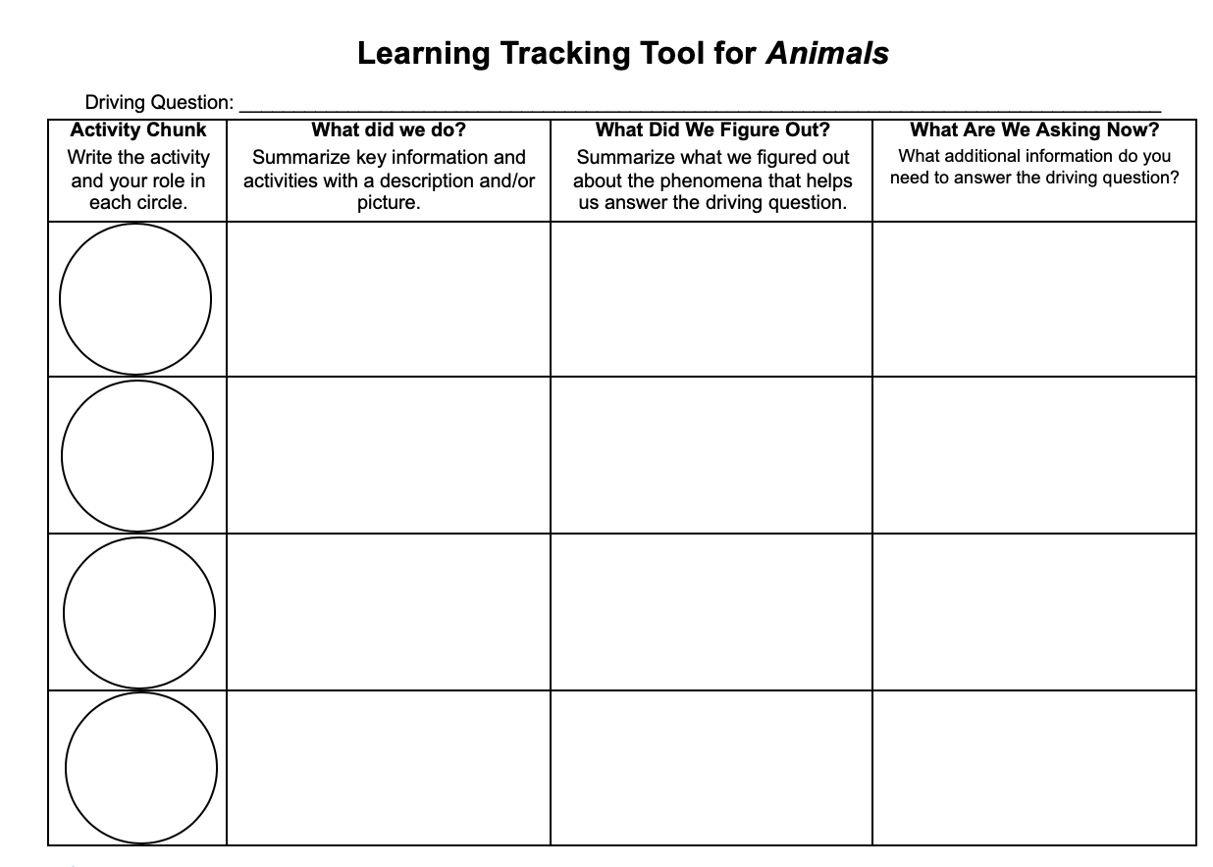
Learning Tracking Tool
For the activity “Questions about Animals,” discuss with your classmates what you figured out will help you to answer the unit driving question. Record your ideas in the column “What We Figured Out.”
Discuss questions you now have related to the unit driving question and record them in the column “What We are Asking Now.”
Notes:
Have a discussion to complete the Learning Tracking Tool for this activity.
Show slide 15 of the 2.4 Questions about Animals PPT.
Pass out a Learning Tracking Tool to each student.
Explain that students will add to the tool after activities to keep track of what they have figured out that will help them to answer the unit driving question.
Have students write the activity name in the first column, "Questions about Animals."
Have a class discussion about what students figured out during the activity that will help them in answering the unit driving question. When you come to consensus as a class, have students record the answer in the second column of the tool.
Have a class discussion about what students are wondering now that will help them move towards answering the unit driving question. Have students record the questions in the third column of the tool.
Have students keep their Learning Tracking Tool for future activities.
Example Learning Tracking Tool
Activity Chunk: Questions About Animals
What Did We Do? “Zoom into" food and examine nutrition labels to learn about the materials in plants, animals, and out food including organic materials (fats, carbohydrates, and proteins).
What We Figured Out: Food is made of molecules that contain matter and energy. These molecules have to get to cells in the animal's body.
What We are Asking Now: What goes in when an animal eats? What comes out?

